Slide 1
CREDIT SCORE CLASSIFICATION
ISDS 574 GROUP 3 PROJECT
Under the Guidance - Dr. Yinfei Kong
Shirin Akbar
Gourav Joshi
Jagruti Jethwani
Deepak Nayak
Sai Krishna Mallineni
Srutej Reddy Kodiganti
Priyanka Raj Siddantham

Slide 2
TABLE OF CONTENTS
INTRODUCTION
METHODS
RESULTS
DISCUSSION
CONCLUSION

Slide 3
INTRODUCTION
Problem Statement: The assessment and prediction of credit scores hold immense significance in the financial domain, influencing lending decisions and financial opportunities for individuals.
Importance Of Credit Classification: Accurate credit scoring models aid financial institutions in evaluating creditworthiness, determining loan approvals, and setting interest rates.

Slide 4
Business Scenario
Applied Industries -
Banking and Lending Institutions:
Relevance: Assess credit risk for loan approvals.
Credit Unions:
Relevance: Determine loan eligibility and terms.
Mortgage Industry:
Relevance: Influence mortgage approvals and interest rates.
Credit Card Companies:
Relevance: Guide credit card approvals and limits.

Slide 5
Classification Problem
Why Classification for Credit Score Prediction?
Capturing Complexity
Diverse Analysis
Data Adaptability
Interpretability and Agility
In summary, classification methods excel in capturing credit intricacies, providing
diverse insights, and adapting to dynamic data, making them superior to linear models.
Notes:
Capturing Complexity:
Non-linear patterns in credit data are better handled by classification methods.
Diverse Analysis:
Logistic regression, decision trees, and knn offer a varied approach for thorough exploration.
Data Adaptability:
Classification copes well with categorical features and class imbalances common in credit datasets.
Interpretability and Agility:
Decision trees provide clear insights, and the methods adapt to evolving credit patterns.
In summary, classification methods excel in capturing credit intricacies, providing diverse insights, and adapting to dynamic data, making them superior to linear models.

Slide 6
Literature Review
Credit Scoring Model with Logistic Regression Chen et al. (2012) proposed a credit scoring model using logistic regression. They employed a stepwise selection procedure to identify the most relevant variables from a pool of financial and demographic data. The resulting model demonstrated satisfactory performance in predicting creditworthiness, suggesting the effectiveness of logistic regression for credit scoring tasks.
https://www.researchgate.net/publication/332381614_Mixed_Credit_Scoring_Model_of_Logistic_Regression_and_Evidence_Weight_in_the_Background_of_Big_Data

Slide 7
Dataset Overview
Our analysis relies on a dataset sourced from kaggle with 28 features.
These features encapsulate critical aspects of individuals’ credit behaviors and financial histories.
https://www.kaggle.com/datasets/parisrohan/credit-score-classification

Slide 8
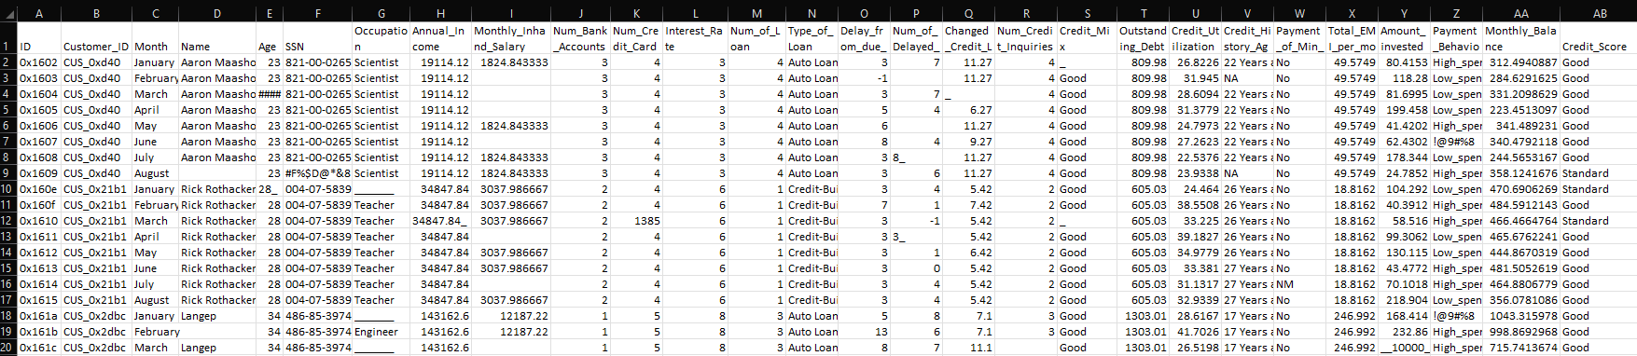
Our original Dataset consists of 100,000 observations with 28 attributes.
The outcome variable here is “Credit Score” with 3 levels Good,Poor and Bad.

Slide 9
Variables
ID
Customer_ID
Name
Month
Age
Occupation
Annual Income
Number of Bank Accounts
Number of Credit Cards
Interest Rate
Number of Loans
Delay from due date
Number of delayed payments
Change of Credit Limit
SSN
Monthly_Inhand_Salary
Type_of_Loan
Number of Credit Inquiries
Credit Mix
Outstanding Debt
Credit Utilization Ratio
Credit History Age
Payment of Min Amount
Total EMI per Month
Amount Invested monthly
Payment Behaviour
Monthly Balance
Credit Score - Target Variable

Slide 10
METHODS

Slide 11
DATA CLEANING AND PREPROCESSING

Slide 12
Removing Special Characters
The provided R script iterates through designated numeric columns, utilizes a Global Substitution (gsub) pattern to eliminate any non-numeric characters, and then transforms the cleaned data into a numeric format.
This process is crucial for preparing the data for further analysis or modeling tasks.

Slide 13
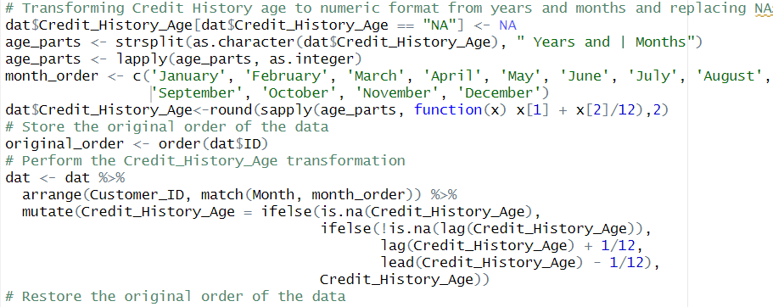
Data Transformation
In data transformation, for example credit history age the process involved converting the original format directly into a numeric value.
This transformation simplifies the representation, making it suitable for numerical calculations and analysis in the context of credit scoring or related tasks.

Slide 14
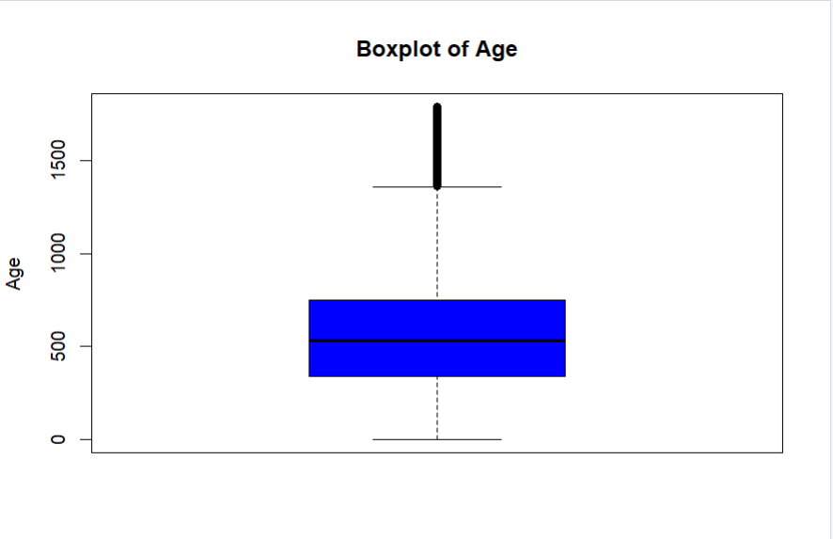
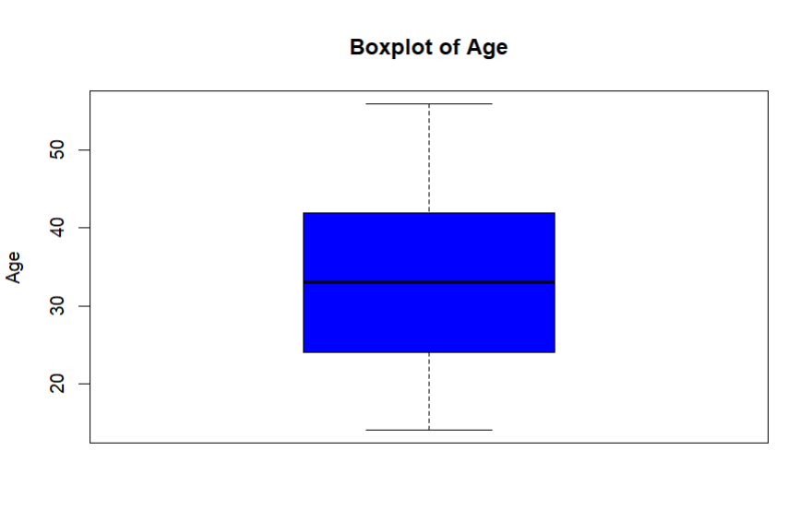
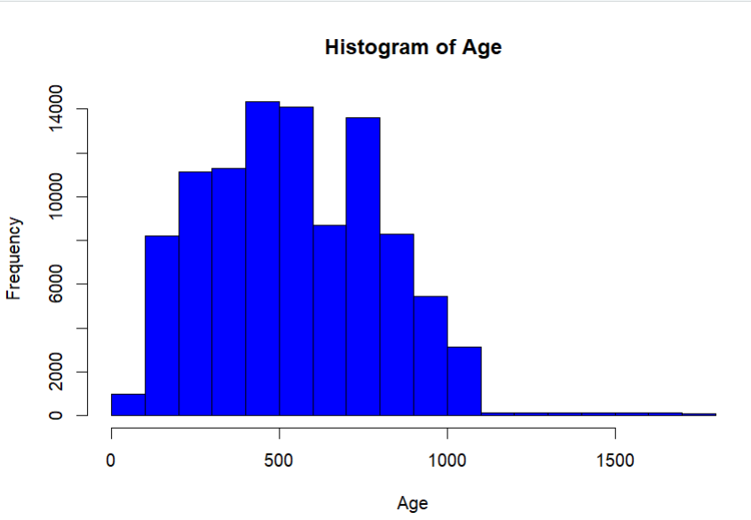
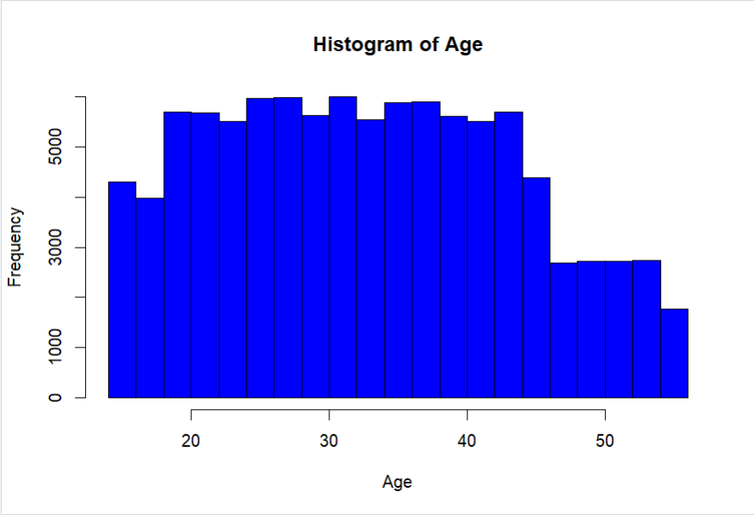
Identifying Outliers
After
After

Slide 15
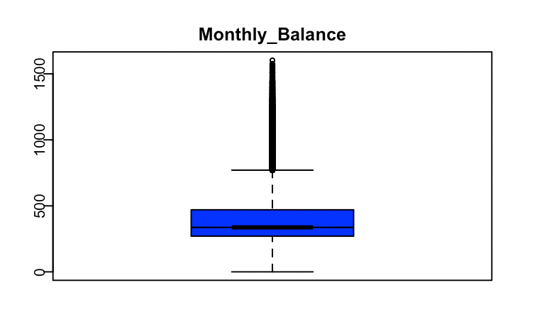
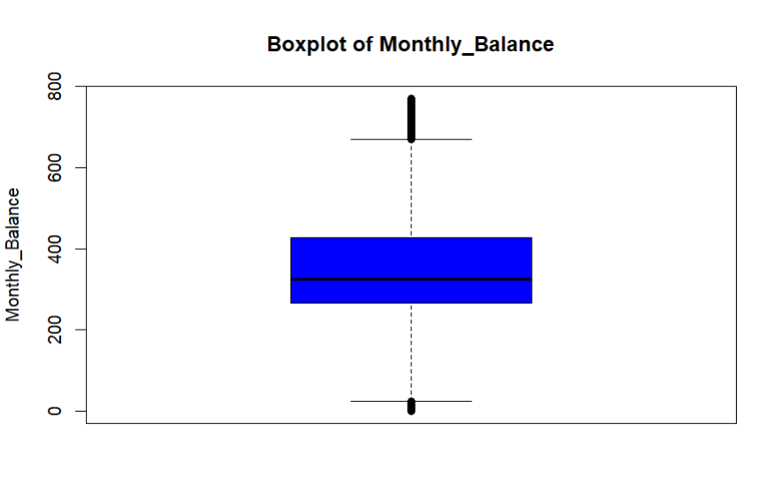
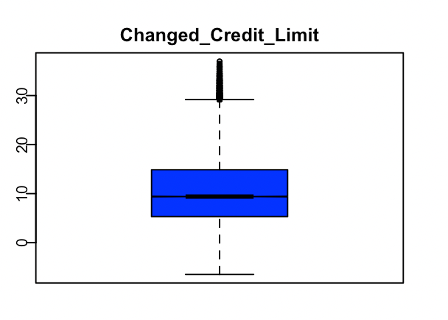
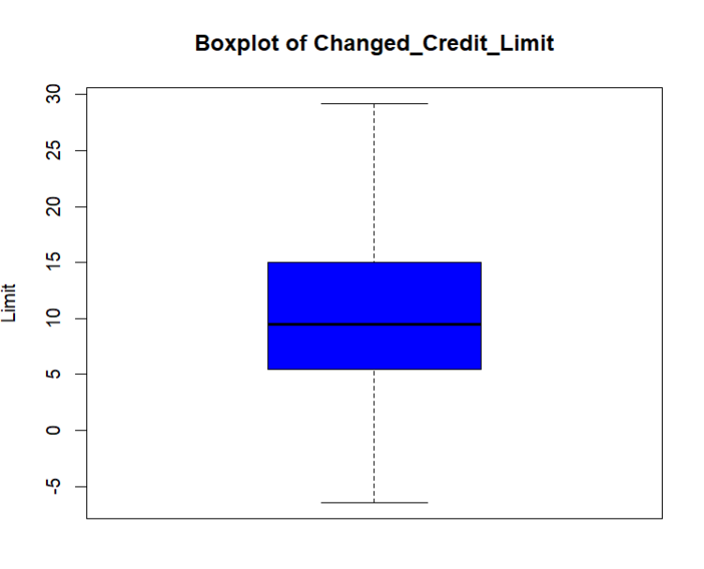
After
After

Slide 16
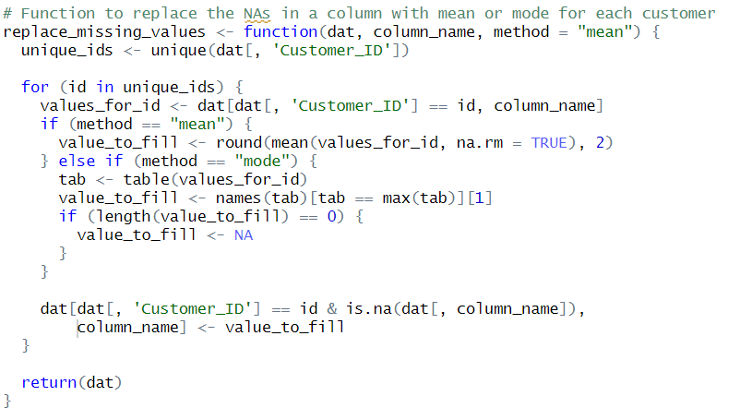
Data Imputation
This function is employed to handle missing values in a designated column of a dataset, utilizing the mean or mode for replacement.

Slide 17
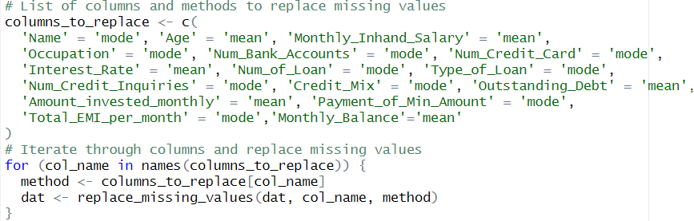
Replacing Missing Values

Slide 18
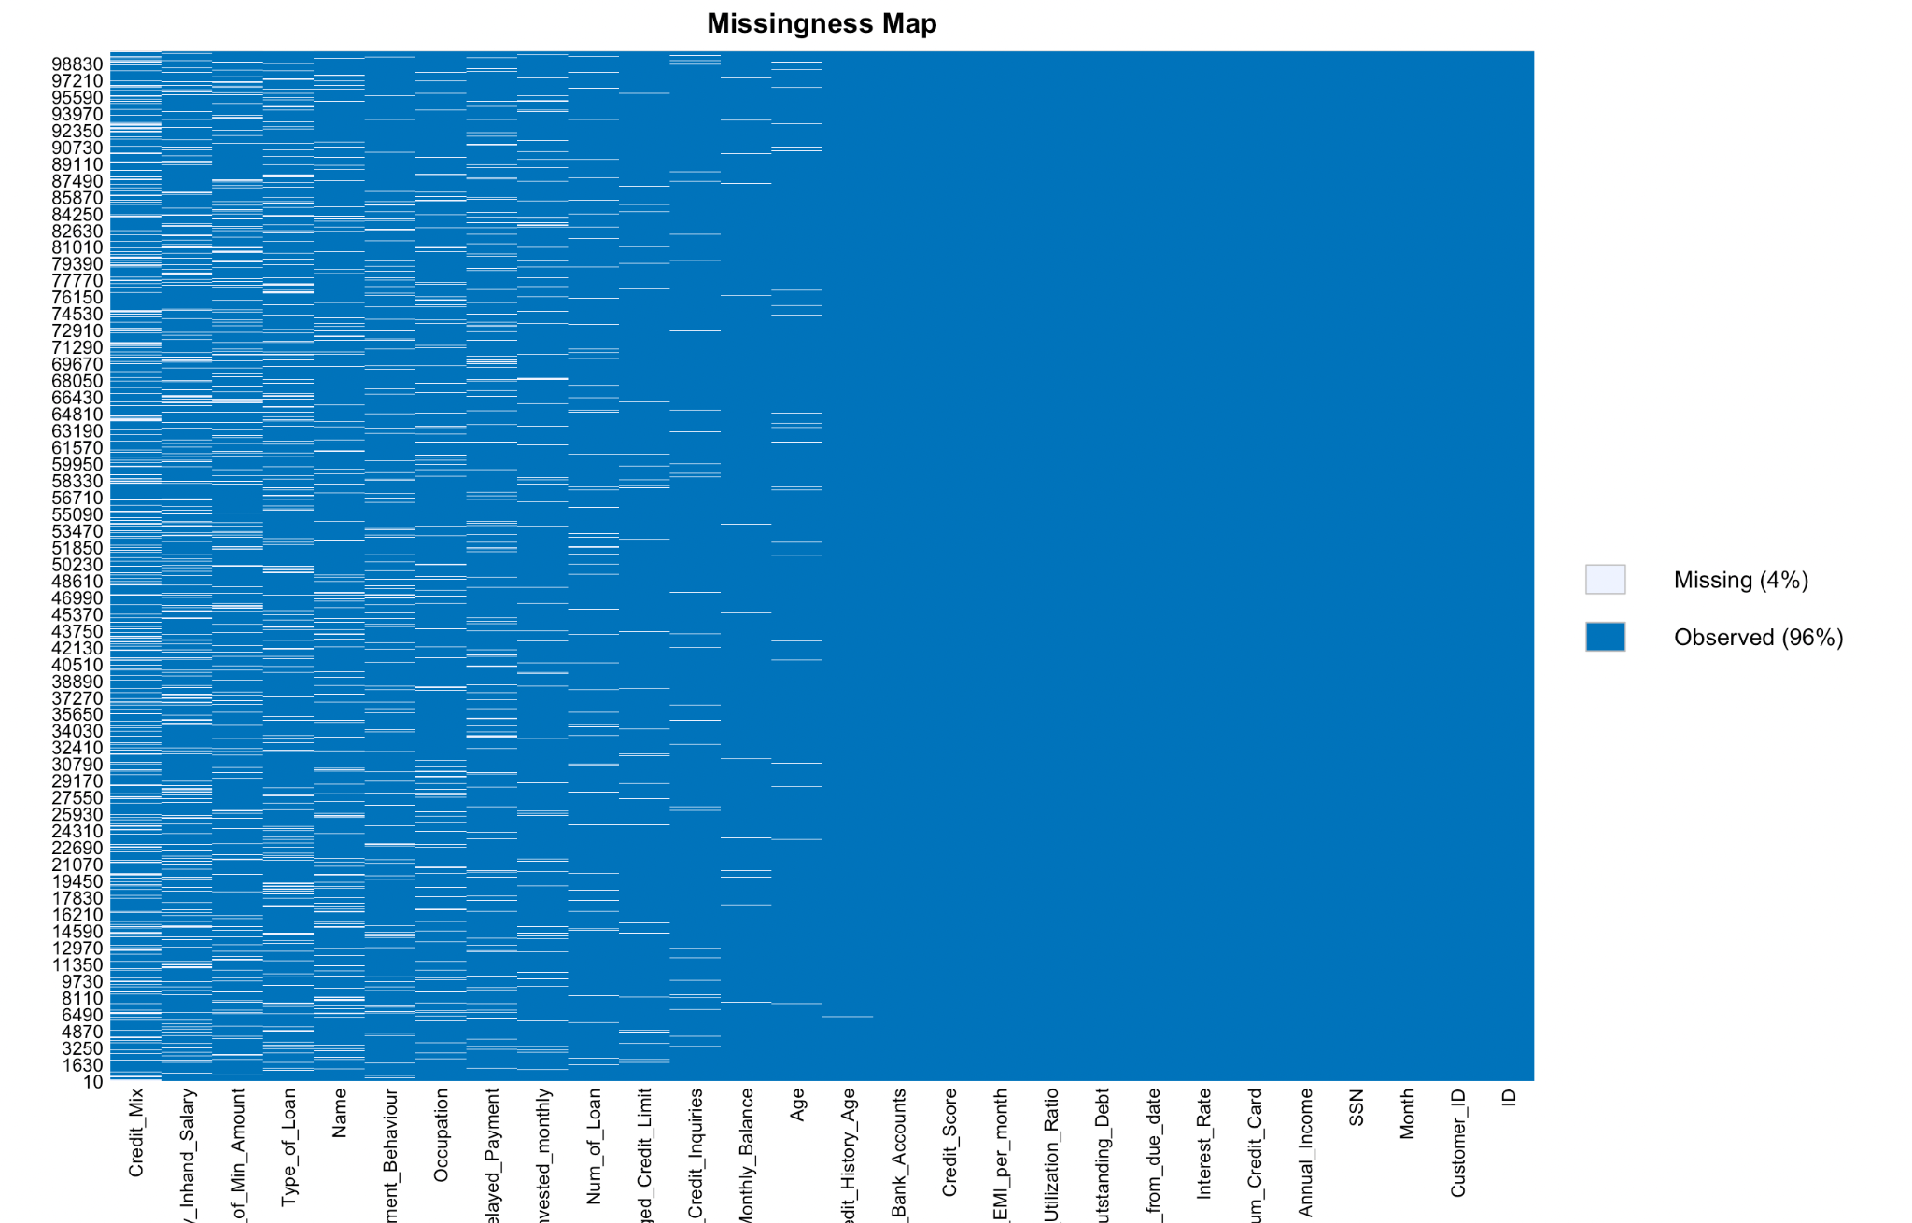
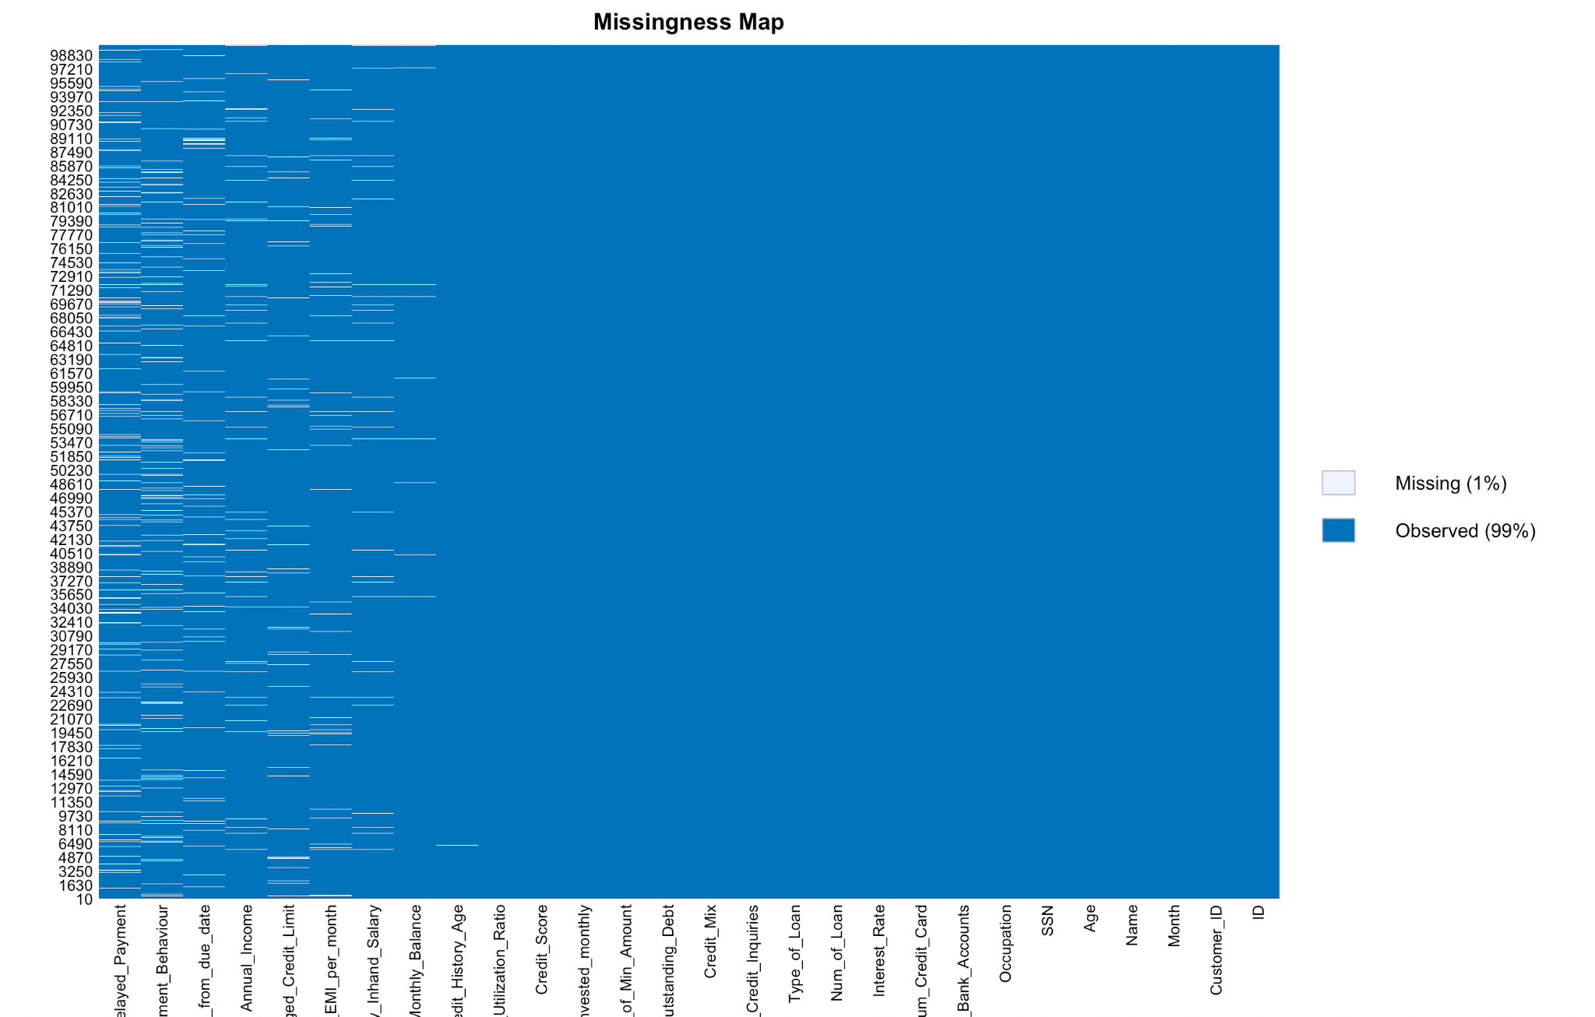
Missingness Map
Before Data Cleaning v/s After Data Cleaning

Slide 19
Correlation
Removing of Columns with High Correlation : Computes a correlation matrix for all numeric columns in the dataset, providing insights into the relationships between different numerical variables and to handle the missing values
Removed Monthly_inHand_Salary : Corr > 0.9

Slide 20
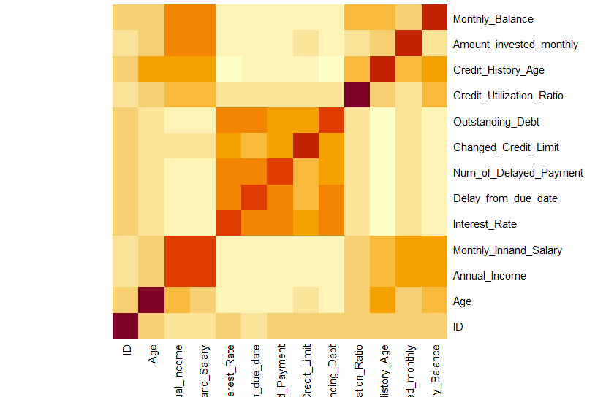
Correlation Heat Map

Slide 21
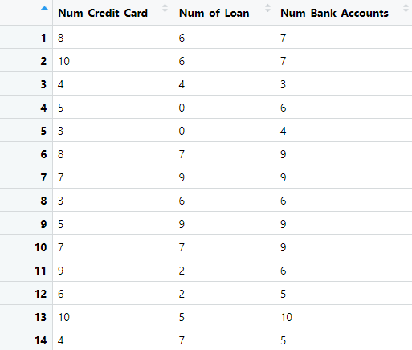
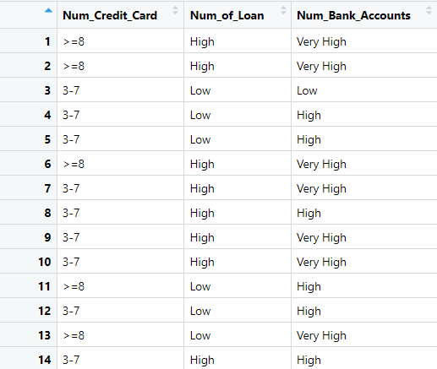
Reducing no of Categories

Slide 22
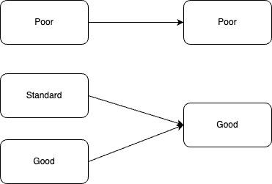
Target Variable
The code simplifies the 'Credit_Score' column into two categories, 'Poor' and 'Good,' by merging the original ‘Standard' and ‘Good' levels into a unified ‘Good’ category, while retaining the ‘Poor’ level as ‘Poor’.

Slide 23
Balancing Data
We had a highly biased data.
Hence, we split the data into another data frame called “balanced_data” which had equal number of both the target variables which are “Good” and “Poor”.
After creating a balanced data, a copy of balanced data was stored into knn_data specifically for KNN.

Slide 24
METHOD IMPLEMENTATION

Slide 25
Model Parameters & Parameters
Threshold set to 0.6,0.7 and 0.8
Then, the balanced data was split into 2 part by 70:30:
df_train.
df_test.

Slide 26
Logistic Regression - Backward and Both
Interest_Rate
Credit_Mix
Num_Credit_Card
Num_Credit_Inquiries
Delay_from_due_date
Payment_of_Min_Amount
Changed_Credit_Limit
Outstanding_Debt
Credit_History_Age
Payment_Behaviour
Amount_invested_monthly
Monthly_Balance
Month
Credit_Utilization_Ratio
Total_EMI_per_month
Age
Num_Bank_Accounts
Annual_Income

Slide 27
Logistic Regression - Forward
Age
Occupation
Annual_Income
Num_Bank_Accounts
Num_Credit_Card + Interest_Rate
Num_of_Loan
Delay_from_due_date
Num_of_Delayed_Payment
Changed_Credit_Limit
Num_Credit_Inquiries
Credit_Mix
Outstanding_Debt
Credit_Utilization_Ratio
Credit_History_Age
Payment_of_Min_Amount
Total_EMI_per_month
Amount_invested_monthly
Payment_Behaviour
Monthly_Balance

Slide 28
Logistic Regression Results
` | Forward |  |  | Backward |  |  | Step
CutOff | Sensitivity | Specificity | Accuracy | Sensitivity | Specificity | Accuracy | Sensitivity | Specificity | Accuracy
0.6 | 0.67624 | 0.81799 | 0.74669 | 0.67513 | 0.81896 | 0.74661 | 0.67513 | 0.81896 | 0.74661
0.7 | 0.48881 | 0.90217 | 0.69424 | 0.48960 | 0.90313 | 0.69511 | 0.48960 | 0.90313 | 0.69511
0.8 | 0.28773 | 0.96402 | 0.62382 | 0.28932 | 0.96402 | 0.62462 | 0.28932 | 0.96402 | 0.62462

Slide 29
Odds Ratio
Forward Logistic regression with cutoff 0.6 has the highest accuracy.
These are the ORs for the most significant 5 variables for the same.
Variable Name | Odds Ratio
Occupation : Lawyer | 1.24074575
Month: March | 1.12980641
Changed_Credit_Limit | 1.0610408
Credit_History_Age | 1.02176995
Age | 1.00395037
Num_of_Delayed_Payment | 1.00390311

Slide 30
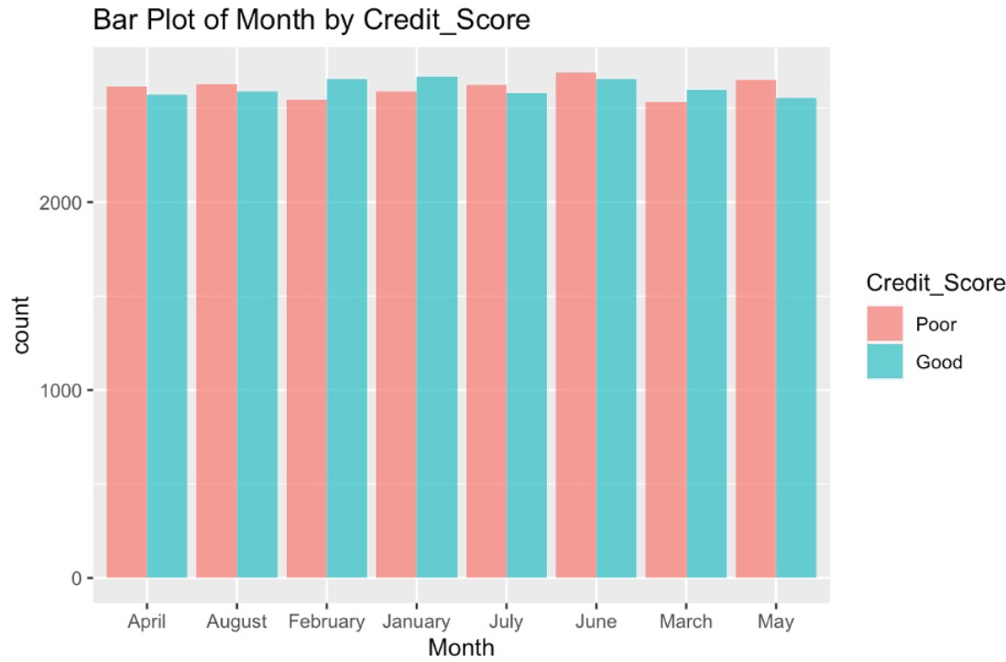
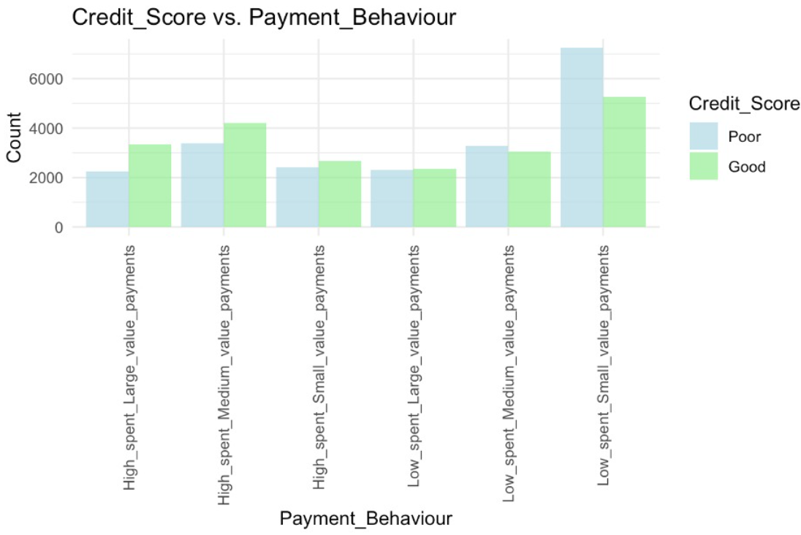
KNN
Numeric Variables selected by KNN:
Best Result from the Logistic Regression.
Categorical Variables:
Variables were selected using different Plots

Slide 31
Select Value of K
Total Variable : 25
Total Observations : 41754
Range For Optimal Value of K = 1 : sqrt(41754)
100 was the max value selected as the sqrt(41754) was too high.

Slide 32
KNN Results
Method | Cutoff | Optimal K | Error Rate | Sensitivity | Specificity | Accuracy
KNN | 0.6 | 5 | 0.22847 | 0.77551 | 0.76755 | 0.77153
KNN | 0.7 | 3 | 0.23374 | 0.76339 | 0.76914 | 0.76626
KNN | 0.8 | 95 | 0.21298 | 0.83769 | 0.73621 | 0.78702

Slide 33
CART
Parameters selected:
minsplit : Minimum number of Splits
xval: No of Cross Validations
cp: Complexity Parameter

Slide 34
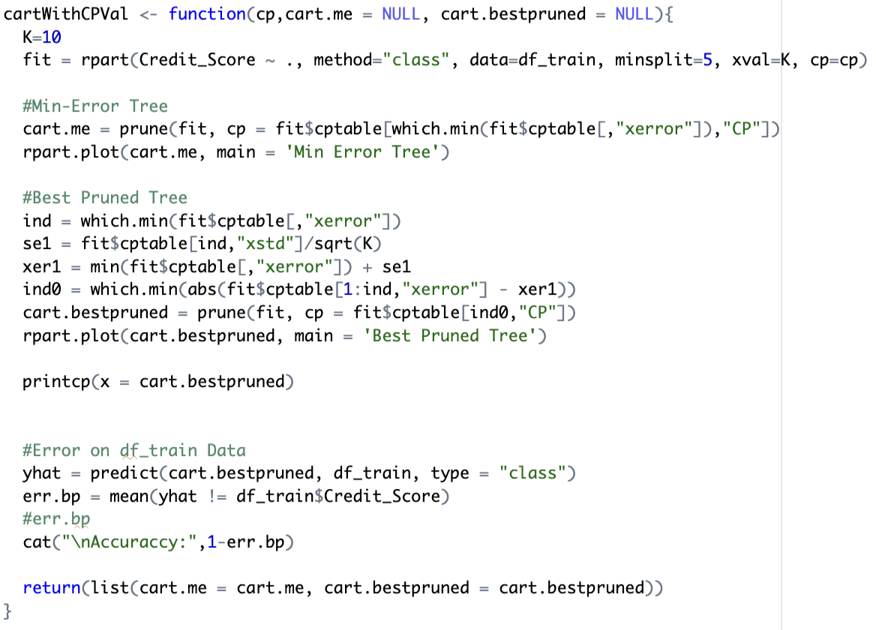
CART
Finding CP

Slide 35
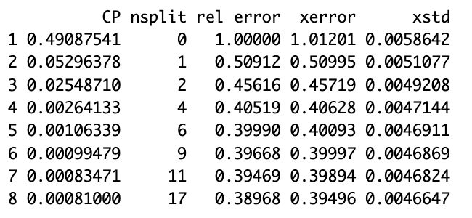
Finding CP

Slide 36
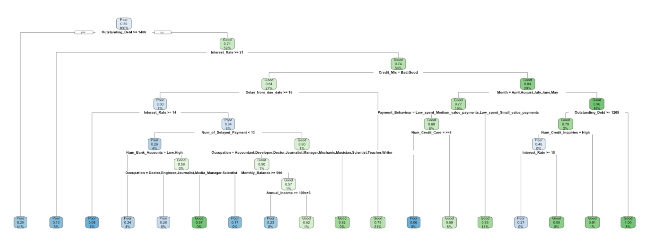
CART- Min Error Tree
Splits
Outstanding_Debt
Interest_Rate
Credit_Mix
Delay_from_due_date
Payment Behaviour
Month
Num_credit_card
Num_credit_inquiries
Num_Bank_Accounts
Occupation
Annual Income.

Slide 37
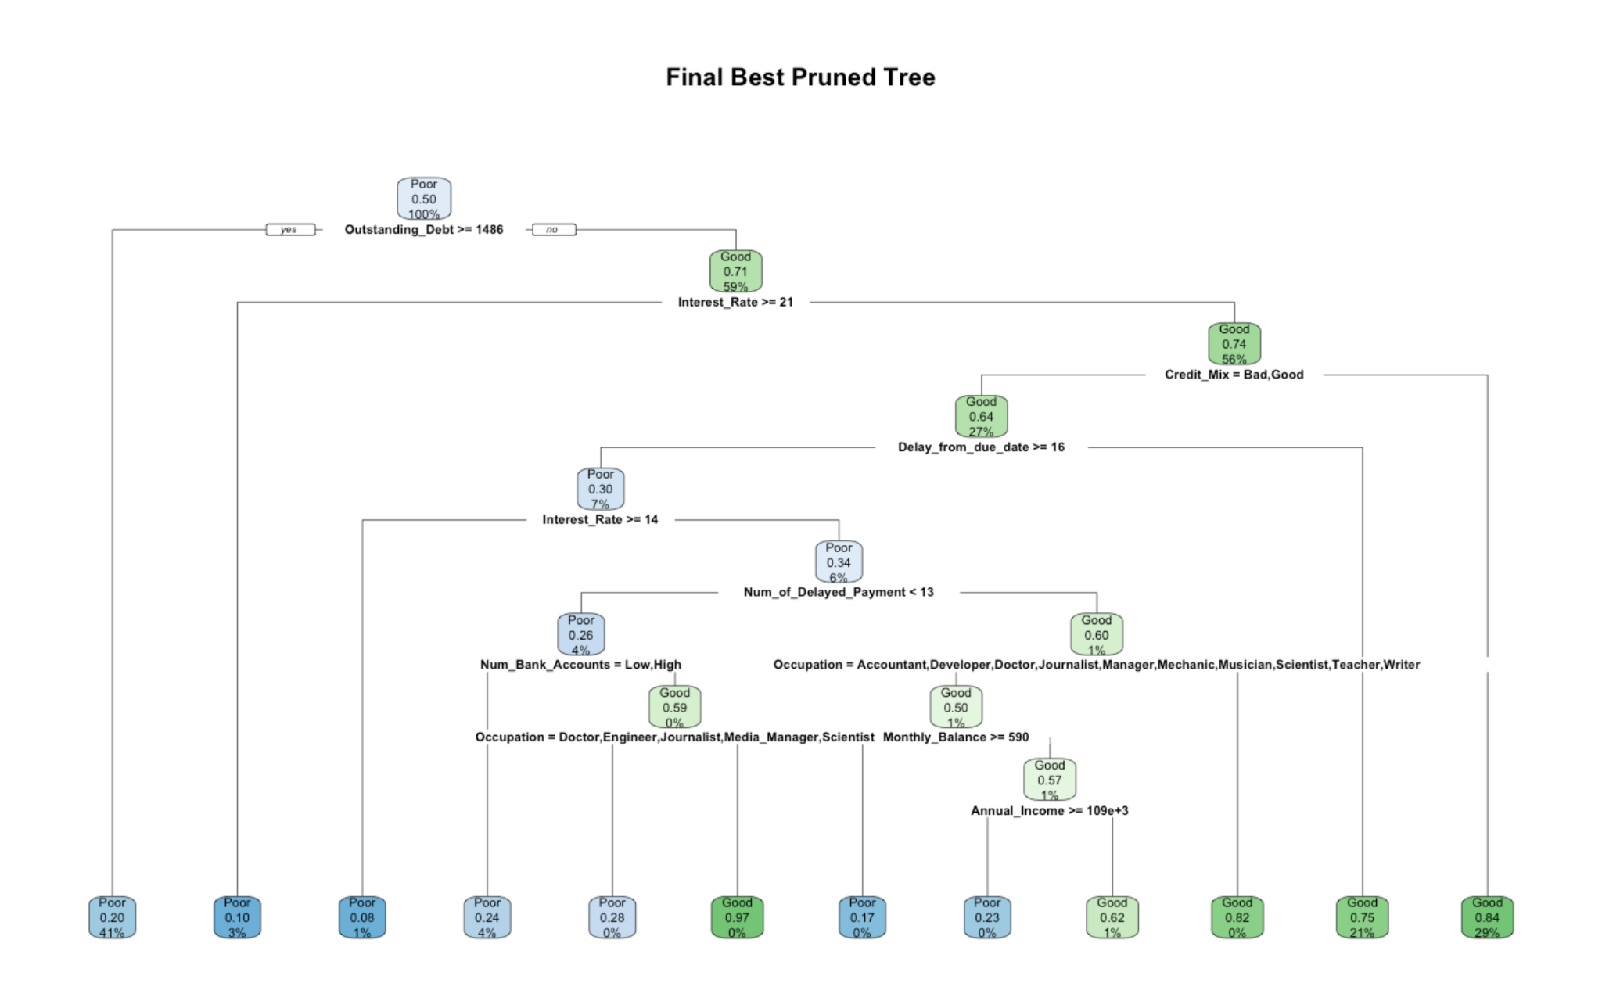
CART - Best Pruned Tree
Splits
Outstanding_Debt
Interest_Rate
Credit_Mix
Delay_from_due_date
Num_Bank_Accounts
Occupation
Annual Income

Slide 38
CART
Output:
Sr. | Method | Cutoff | ErrorRate | Sensitivity | Specificity | Accuracy
1 | CART-ME Tree | 0.6 | 0.19433 | 0.80783 | 0.80351 | 0.80567
2 | CART-ME Tree | 0.7 | 0.22656 | 0.68983 | 0.85661 | 0.77344
3 | CART-ME Tree | 0.8 | 0.33047 | 0.37864 | 0.95891 | 0.66953
4 | CART-BP Tree | 0.6 | 0.19683 | 0.80989 | 0.79648 | 0.80317
5 | CART-BP Tree | 0.7 | 0.19847 | 0.80132 | 0.80173 | 0.80153
6 | CART-BP Tree | 0.8 | 0.30238 | 0.49012 | 0.90404 | 0.69762

Slide 39
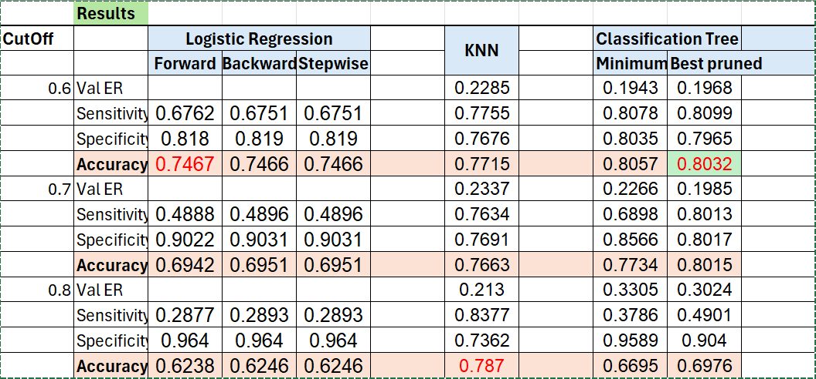
Results
Upon Comparing all 3 models, we find that the CART has the Highest Accuracy of 80.31%.

Slide 40
Observations
KNN tends to have higher sensitivity
Varying performances across cut offs
Accuracy is influenced by balance between sensitivity and specificity
Considerations
Choice of cutoff should align with business priorities
Further analysis

Slide 41
Discussion
Implications:
Lending Decisions: Better credit score predictions aid in informed and accurate lending decisions.
Risk Management: Accurate classifications help in mitigating financial risks associated with lending.
Customer Insights: Understanding credit behavior provides insights into customer profiles and risk levels.
Applications:
Financial Institutions: Enhance loan approval processes and risk assessments.
Credit Scoring Agencies: Improve the accuracy of credit score predictions for individuals.
Personal Finance Tools: Empower individuals with better financial planning and credit management advice based on accurate assessments.

Slide 42
Conclusion
Limitation: Credit score classification may face challenges related to data quality, static representation, economic factors, limited context, and fairness concerns.
Future Work : Future efforts in credit score classification could focus on incorporating alternative data, developing dynamic models, ensuring explainability, exploring behavioral analytics, enhancing privacy measures, implementing continuous model monitoring, and promoting global standards.

Slide 43
THANK YOU !

